Slide 1
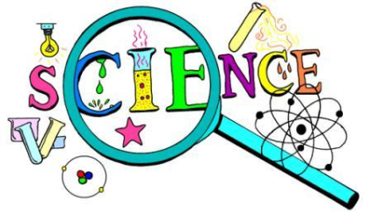
Science Topics
Weather
Farm Animals
Seasons
Colors
Living/Nonliving
Metamorphosis
Apples
Plants
Pumpkins
Nutrition
Hibernation
The 5 Senses
Shadows
Life Cycles

